Slide 1
Dynamic Host Configuration Protocol (DHCP)

Slide 2
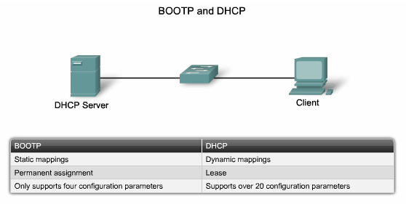
BOOTP vs DHCP

Slide 3
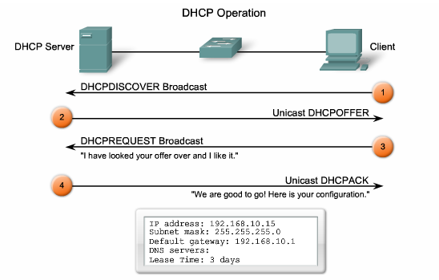
DHCP operation

Slide 4
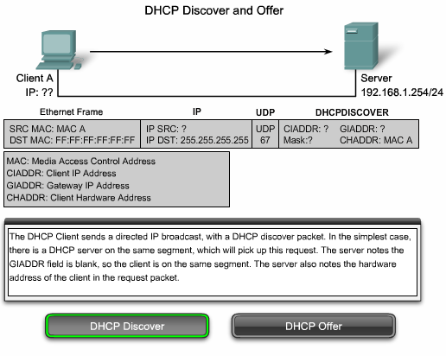
DHCP operation

Slide 5
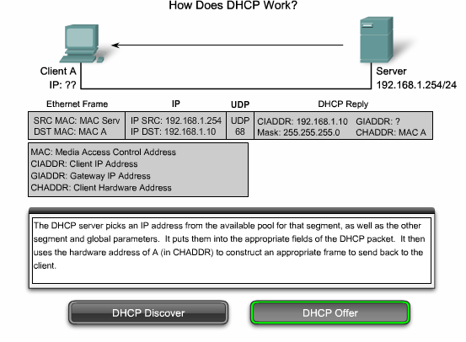
DHCP operation

Slide 6
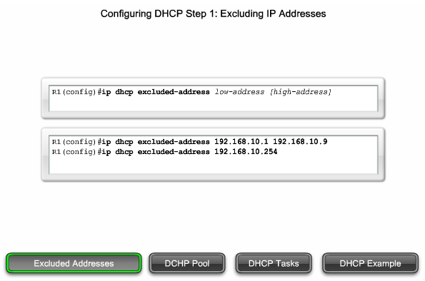
DHCP configuration

Slide 7
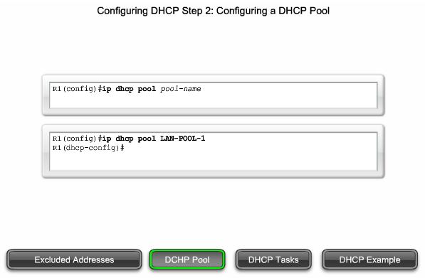
DHCP configuration

Slide 8
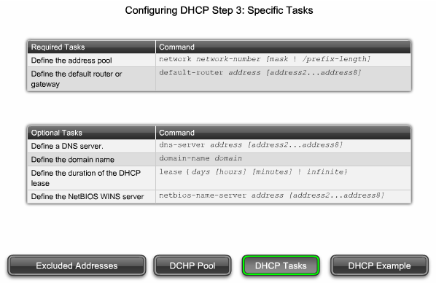
DHCP configuration

Slide 9
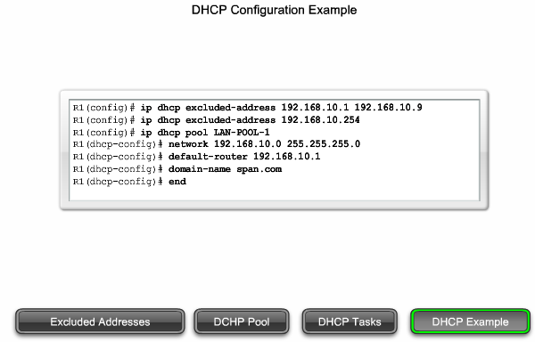
DHCP configuration

